Slide 1
Code Review Training Course. Part 5b: Mobile Application
For VIB only
namhabach@gmail.com

Slide 2
Outline
1
2
3
Mobile Application Risk
iOS Structure
Android Structure
4
Code Review

Slide 3
iOS Structure

Slide 4
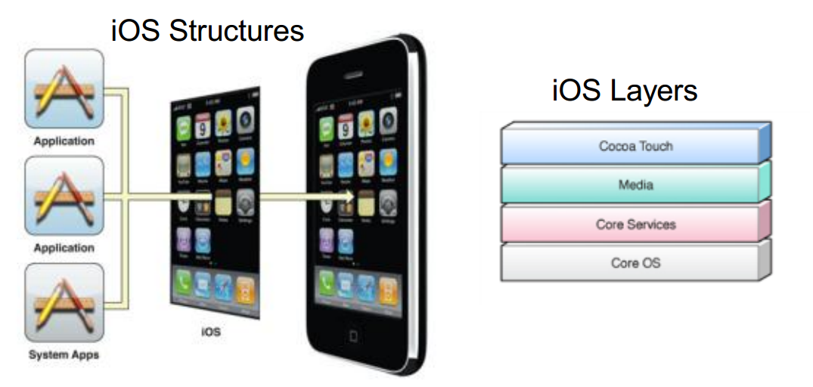
iOS in a nutshell

Slide 5
Cocoa Touch Layer
Key framework for building an Application
Key Functionalit
Storyboards Document Support
Multitasking Printing
Data Protection Apple Push Notification
Local Notifications Gesture Recognizers
File-Sharing Support Peer-to-Peer Services
Standard System View External Display Support

Slide 6
Media Layer
Layer consist of four major technologies -
Graphics Technologies
Audio Technologies
Video Technologies
AirPlay

Slide 7
Core Services Layer
Have core Operating System features
iCloud Storage (Documents & Key-Value data)
Automatic Reference Counting
Block Objects
Grand Central Dispatch
In-App Purchase
SQLite
XML Support

Slide 8
Core OS Layer
The Core OS layer contains the low-level features that most other technologies are built upon
Even if you do not use these technologies directly in your applications, they are most likely being used by other frameworks
Core OS layer is responsible for hardware communication

Slide 9
Core OS Layer
This layer has couple of important Security Framework along with framework to perform math calculation, third party hardware communication, Bluetooth communication, threading, networking, File System access, Standard I/O, Bonjour, DNS and Memory allocation.

Slide 10
Android

Slide 11
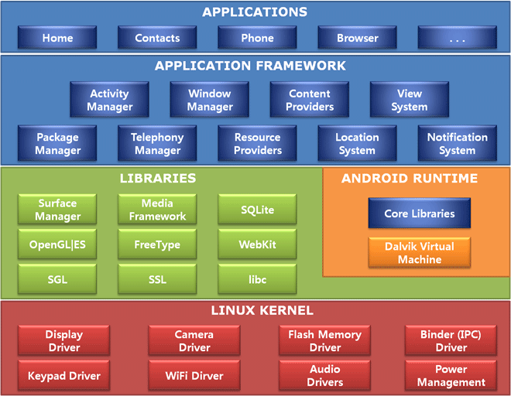
Android Structure

Slide 12
Android
Store - Android Market
UI – Java Application Framework
Browser – Webkit
Graphics – OpenGL
Language – Java
VM – Dalvik VM

Slide 13
Mobile Application Risk

Slide 14
Mobile Application Risk
Insecure Storage
Insecure Network Communication
PII Information Leakage
Hardcoded Secrets
Language Specific Issues
SQL Injection in Local database
Logical Issues

Slide 15
Insecure Storage

Slide 16
Insecure Storage
Why application needs to store data
Ease of use for the user
Popularity
Competition
Activity with single click
Decrease Transaction time
Post/Get information to/from Social Sites
9 out of 10 applications have this vulnerability

Slide 17
Insecure Storage
How attacker can gain access
Wifi
Default password after jail breaking
Physical Theft
Temporary access to device

Slide 18
Insecure Storage
What information we usually find
Authentication Credentials
Authorization tokens
Financial Statements
Credit card numbers
Owner’s Information – Physical Address, Name,
Phone number
Social Engineering Sites profile/habbits
SQL Queries

Slide 19
Code Review
Android
Don`t use world readable and writeable permission
MODE_PRIVATE
iOS
Use Keychain
Save in correct folder:
Application.app | Lưu trữ các nội dung cố định của ứng dụng và mã thực thi của ứng dụng. Các nội dung này được ký và kiểm tra khi thực thi
Documents | Là nơi lưu trữ các dữ liệu thường xuyên cho ứng dụng; dữ liệu trong thư mục này được đồng bộ và sao lưu với iTunes.
Library | Thư mục này chứa các dữ liệu hỗ trợ cho ứng dụng thực thi như file cấu hình, tham chiếu, dữ liệu cache, cookies.
tmp | Lưu trữ các file tạm.

Slide 20
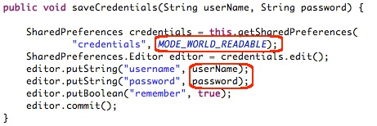
Androi - World readable

Slide 21
iOS – Use Correct Level
No Protection | File không mã hóa. Dùng lưu trữ những dữ liệu tạm, không quan trọng. | NSDataWritingFileProtectionNone | NSFileProtectionNone
Complete Protection | File được mã hóa và không thể truy cập khi thiết bị ở trạng thái lock. Dùng lưu trữ các dạng dữ liệu cần bảo vệ cao, khi lock máy thì không cho phép truy cập dữ liệu | NSDataWritingFileProtectionComplete | NSFileProtectionComplete
Complete Unless Open | File được mã hóa. Khi file đang được mở bởi một ứng dụng mà thiết bị chuyển sang trạng thái lock thì chỉ ứng dụng đó được tiếp tục thao tác với file cho đến khi đóng, còn các ứng dụng khác không thể truy cập đến file. Giống dạng Complete Protection, tuy nhiên cho phép các ứng dụng đang thao tác với file được thực thi tiếp , phù hợp với các trường hợp như đang download. | NSDataWritingFileProtectionCompleteUnlessOpen | NSFileProtectionCompleteUnlessOpen
Complete Until First User Authentication | File được mã hóa và không thể truy cập cho đến khi lần đầu unlock thiết bị sau khi khởi động máy. Dùng để bảo vệ dữ liệu khỏi các kiểu tấn công cần khởi động lại máy. | NSDataWritingFileProtectionCompleteUntilFirstUserAuthentication | NSFileProtectionCompleteUntilFirstUserAuthentication

Slide 22
Insecure Network Communication

Slide 23
Insecure Network Communication
Important to encrypt data in the transmission
Easy to perform MiM attacks as Mobile devices uses untrusted network i.e open/Public WiFi, HotSpot, Carrier’s Network
Application deals with sensitive data i.e.
Authentication credentials
Authorization token
PII Information (Privacy Violation) (Owner Name, Phone number, UDID

Slide 24
Insecure Network Channel
Can sniff the traffic to get an access to sensitive data
SSL is the best way to secure communication channel
Common Issues
Does not deprecate HTTP requests
Allowing invalid certificates
Sensitive information in GET requests

Slide 25
PII Information Leakage
Application usually have access to user’s private information i.e. Owner Name, Location, Physical Address, AppID, Phone Number
This information needs to be handled very carefully as per the law in some countries
Storing this information in plain text is not allowed in some countries

Slide 26
Hardcoded Secrets

Slide 27
Hardcoded Secrets
Easiest way for developer to solve complex issues/functionality
Attacker can get this information by either reverse engineering application or by checking local storage

Slide 28
Language Specific Issues

Slide 29
Language Specific Issues
Application in iOS are developed in Objective C language which is derived from classic C language
Along with this derivation, it also derives security issues in C language i.e. overflow attacks

Slide 30
What Are Buffer Overflows (BOs)?
External data is larger than the destination
Overflowing the destination tramples some sensitive, in-memory construct that determines execution flow
Causing the application to change execution flow
To the attacker’s code that is included in the data
Cause: Trusting input
C/C++ code the most common victim
Direct access to memory

Slide 31

Stack Buffer Overflows at Work
All determine execution flow
Function return address
Exception Handlers
Function Pointers
Virtual Methods
Buffers
Other vars
EBP
EIP
Args
void func(char *p, int i) {
int j = 0;
CFoo foo;
int (*fp)(int) = &func;
char b[128]; strcpy(b,p);
}
0wn3d!
Bad things happen if *p points to data longer than b

Slide 32
Heap Overflows at Work
Write a DWORD
anywhere in memory
when block is free()’d
0wn3d!
Heap Block
Heap Block
Heap Block
Pointer to prior block
A₁
D₁
A₂
D₂
Pointer to next block
On block free:
D1 → [A1] D2 → [A2]

Slide 33
Code Review
Input Validation
Use C-obj function
C | C-Obj
strcat | strlcat
strcpy | strlcpy
strncat | strlcat
strncpy | strlcpy
sprintf | snprintf or asprintf
vsprintf | vsnprintf or vasprintf
gets | fgets

Slide 34
Injection in Local database

Slide 35
SQL Injection in Local database
Most Mobile platforms uses SQLite as database to store information on the device
Using any SQLite Database Browser, it is possible to access database logs which has queries and other sensitive database information
In case application is not filtering input, SQL Injection on local database is possible
Don`t forget: File Inclusion
Filter (%00, \0, 0x00) when file access

Slide 36
Secure Coding ???
String username = Username.getText().toString();
String password = Password.getText().toString();
SQLiteDatabase db = mDbHelper.getWriteableDatabase();
String userQuery = "SELECT * FROM useraccounts WHERE user_name = '" + username + "' and password = '" + password + "'";
SQLiteStatement prepStatement = db.compileStatement(userQuery);

Slide 37
Secure Coding - Android
SQLiteDatabase db = mDbHelper.getWriteableDatabase();
String userQuery = "SELECT * FROM useraccounts WHERE user_name = ? and password = ?";
prepStatement.bindString(1,Username.getText().toString()("user_name");
prepStatement.bindString(2,Username.getText().toString()("password"));
SQLiteStatement prepStatement = db.compileStatement(userQuery);

Slide 38
Secure Coding - iOS
sqlite3 *database;
sqlite3_stmt *statement;
if(sqlite3_open([databasePath UTF8String], &database) == SQLITE_OK)
{
const char *insert_stmt = “INSERT INTO messages VALUES(‘1’, ?, ?, ?)”;
sqlite3_prepare_v2(database, insert_stmt, -1, &statement, NULL);
sqlite3_bind_text(&insert_stmt, 1, [msg UTF8String], -1, SQLITE_TRANSIENT);
sqlite3_bind_text(&insert_stmt, 2, [user UTF8String], -1, SQLITE_TRANSIENT);
sqlite3_bind_text(&insert_stmt, 3, [displayname UTF8String], -1, SQLITE_TRANSIENT);
if (sqlite3_step(statement) == SQLITE_DONE)

Slide 39
Information in Common Services

Slide 40
Information in Common Services
KeyBoard, Clipboard are shared amongst all the applications.
Information stored in clipboard can be accessed by all the application
Sensitive information should not be allowed to copy/paste in the application

Slide 41
Android - Activity
Secure Create Activity
<manifest xmlns:android="http://schemas.android.com/apk/res/android"
package="com.example.testapps.test1">
...
<activity
android:exported="true"
android:name=".User_login"
android:label="@string/title_activity_main"
android:configChanges="orientation"
android:theme="@android:style/Theme.Black">
<intent-filter>
…
</intent-filter>
</activity>
...
</manifest>
Any program can call this Activity

Slide 42
Android - Activity
Secure Level: normal, dangerous, signature,, signatureOrSystem
<permission android:name="com.example.testapps.test1.permission.User_login"
android:protectionLevel="signature"
android:label="@string/permission_label"
android:description="@string/permission_desc">
</permission>
…
<activity
android:name=".User_login"
android:label="@string/title_activity_main"
android:configChanges="orientation"
android:theme="@android:style/Theme.Black"
android:permission="com.example.testapps.test1.permission.User_login">

Slide 43
Android - Activity
Hacker call register intent-filter with name “tel”
Secure Call Activity
…
Intent i = new Intent(Intent.ACTION_DIAL);
i.setData(Uri.parse("tel:0986286086"));
startActivity(i);
…
…
intent i = new Intent(Intent.ACTION_VIEW);
i.setData(Uri.parse("tel:0986286086"));
i.setComponent(new ComponentName("mycontext" , "trustactivity"));
startActivity(i);
…

Slide 44
Android - Content Provider
<manifest xmlns:android="http://schemas.android.com/apk/res/android"
package="com.example.testapps.test1">
...
<provider android.name="com.example.testapps.test1.MailProvider"
android.authorities="com.example.testapps.test1.mailprovider" >
</provider>
...
</manifest>

Slide 45
Android - Content Provider
<manifest xmlns:android="http://schemas.android.com/apk/res/android"
package="com.example.testapps.test1">
...
<permission android:name="com.example.testapps.test1.permission.DB_READ" android:protectionLevel="dangerous"…</permission><permission android:name="com.example.testapps.test1.permission.DB_WRITE" android:protectionLevel="dangerous"...</permission> ...
<provider android.name="com.example.testapps.test1.MailProvider"
android.authorities="com.example.testapps.test1.mailprovider"
android.readPermission="com.example.testapps.test1.permission.DB_READ"
android.writePermission="com.example.testapps.test1.permission.DB_WRITE">
<grant-uri-permission android:path="/attachments/" />
</provider>
...
</manifest>

Slide 46
Server Side Issues

Slide 47
Server Side Issues
Most Application makes server side calls to either web services or some other component. Security of server side component is equally important as client side
Controls to be tested on the server side – Security Control Categories for Server Side Application– Authentication, Access Controls/Authorization, API misuse, Path traversal, Sensitive information leakage,

Slide 48
Server Side Issues
Error handling, Session management, Protocol abuse, Input validations, XSS, CSRF, Logic bypass, Insecure crypto, DoS, Malicious Code Injection, SQL injection, XPATH and LDAP injections, OS command injection, Parameter manipulations, BruteForce, Buffer Overflow, HTTP response splitting, HTTP replay, XML injection, Canonicalization, Logging and auditing.

Slide 49
Code Review – Prevent XSS - Android
When use Webview:
setJavaScript Enabled(false);
…
WebView myWebView = (WebView) findViewById(R.id.webview);
WebSettings webSettings = myWebView.getSettings();
webSettings.setJavaScriptEnabled(true);
myWebView.loadUrl("http://www.malicious.com");
…

Slide 50
Code Review – Prevent XSS - iOS
When use stringByEvaluatingJavaScriptFromString:
Validate input

Slide 51
Code Review – Prevent XSS - iOS
When use stringByEvaluatingJavaScriptFromString:
Validate input

Slide 52
Code Review – Prevent Tapjacking- Android
When use important layout:
filterTouchesWhen Obscured
<Button android:text="Buy"
android:id="@+id/buy"
android:layout_width="wrap_content"
android:layout_height="wrap_content"
android:filterTouchesWhenObscured="true">
</Button>

Slide 53
Logical Issues

Slide 54
Logical Issues
Authentication flags and privilege escalations at application layer
Critical parameter manipulation and access to unauthorized information/content
Business constraint exploitation
Identity or profile extraction
Denial of Services (DoS) with business logic

Slide 55
Check password policy
public static boolean isStrongPassword(String password) {
String pattern = "((?=.*[0-9])(?=.*[a-zA-Z])(?=.*[@#$%^&+=]).{8,})";
return password.matches(pattern);
}

Slide 56
Log – Debug

Slide 57
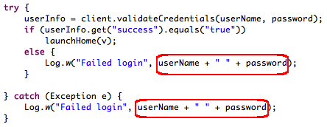
Log – Debug - Android
Don`t log user information
Disable debug mode in androidmanifest.xml
<application android:debuggable="false"/>

Slide 58
Log – Debug - iOS
Must prevent Format String
Input Validation: ”%n”, ”%@”, ...
Use NSLog

Slide 59
Secure Source Code
Don`t hard code key:
Password, CC
Obfuscate code:
Android: ProGuard
iOS: Generate Position-Dependent Code (XCode)
Secure Compliler (iOS):
-fstack-protector-all
Objective-C Automatic Reference Counting : YES

Slide 60
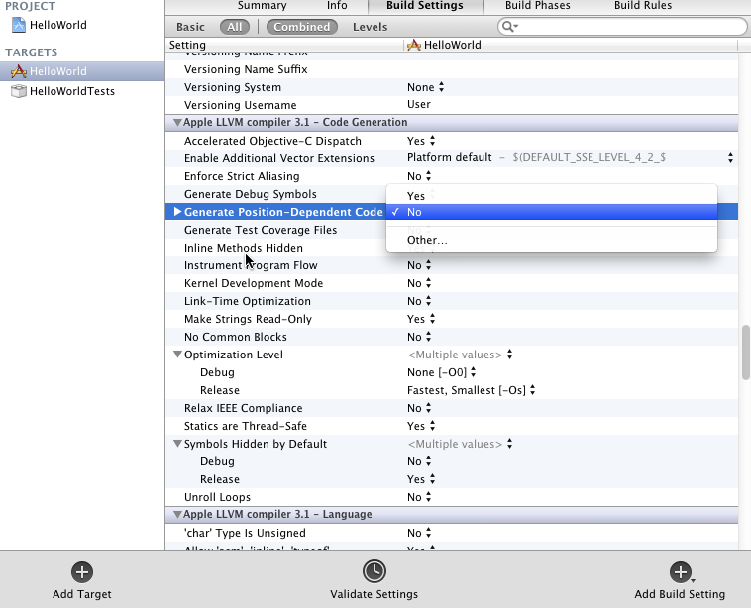
iOS - Generate Position-Dependent Code

Slide 61
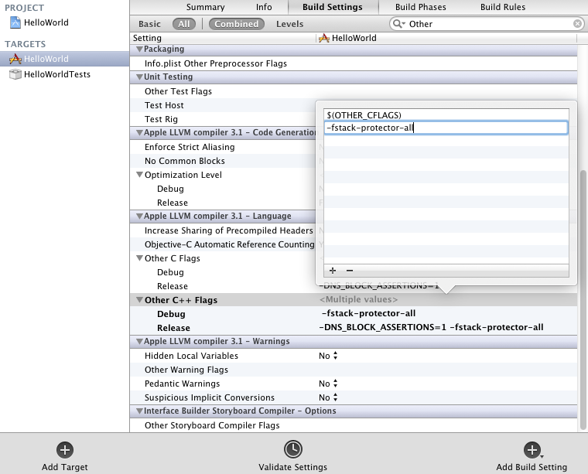
iOS -fstack-protector-all

Slide 62
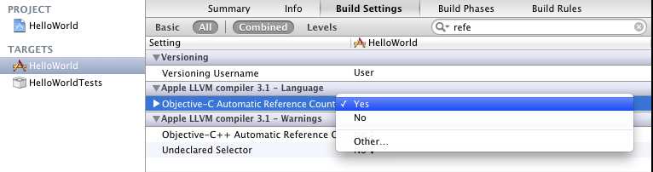
iOS - Objective-C Automatic Reference Counting

Slide 63
Other

Slide 64
Questions?

Slide 65
#Enter to next part_>
End of Part 6

